Slide 1

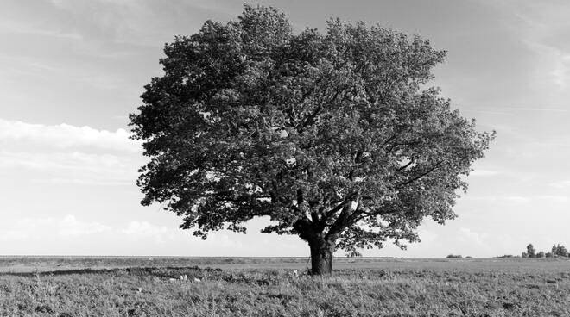

Slide 2
0 | 0 | 1 | 1 | 1 | 1 | 0 | 0
0 | 0 | 1 | 1 | 1 | 1 | 1 | 0
0 | 1 | 1 | 1 | 1 | 1 | 1 | 0
0 | 1 | 1 | 1 | 1 | 1 | 1 | 0
0 | 1 | 1 | 1 | 1 | 1 | 1 | 0
0 | 1 | 1 | 1 | 1 | 1 | 1 | 0
0 | 0 | 1 | 0 | 1 | 1 | 0 | 0
0 | 0 | 0 | 0 | 0 | 0 | 0 | 0
1 | 1 | 1 | 2 | 1 | 2
1 | 2 | 3 | 3 | 3 | 1
1 | 3 | 3 | 3 | 3 | 2
2 | 3 | 3 | 4 | 3 | 1
1 | 2 | 3 | 3 | 3 | 2
1 | 1 | 1 | 2 | 1 | 1
0 | 1 | 0
0 | 1 | 1
1 | 0 | 1

Slide 3
y
Albero tipo 1
Albero tipo 2
1 | 1 | 1 | 2 | 1 | 2
1 | 2 | 3 | 3 | 3 | 1
1 | 3 | 3 | 3 | 3 | 2
2 | 3 | 3 | 4 | 3 | 1
1 | 2 | 3 | 3 | 3 | 2
1 | 1 | 1 | 2 | 1 | 1
Il max
3 | 3
3 | 4
Albero tipo 3
Albero tipo 4
x

Slide 4
1 | 1 | 1 | 2 | 1 | 2
1 | 2 | 3 | 3 | 3 | 1
1 | 3 | 3 | 3 | 3 | 2
2 | 3 | 3 | 4 | 3 | 1
1 | 2 | 3 | 3 | 3 | 2
1 | 1 | 1 | 2 | 1 | 1
FILTRO DI CONVOLUZIONE 3x3
Max Pooling 2x2
3 | 3
3 | 4
Feature Map

